Slide 1
MACHINE LEARNING CAPSTONE
Flight Arrival
Delay Prediction
How late will it land, the moment it leaves the gate?
5.69M
8
0.965
7.3 min
flights
models
test ROC-AUC
mean error
Khalid Al Dosari · Abdulaziz Alshareef · Anas Alzahrani · Feras Madkhali
Tuwaiq Bootcamp

Slide 2
Two questions, one moment
Same rows, same features, same split
Classification
Regression
ArrDel15: will it land 15 minutes late or more?
Judged on ROC-AUC, not Accuracy
ArrDelay: how many minutes late, and it can be negative
Judged on R2 and mean absolute error
Why it is worth doing
Why a model and not a formula
Airlines, airports and connecting passengers need a sharper number than the printed schedule once a plane pushes back.
Delay depends on how late the plane already is, ground congestion, route, carrier and time of day, all interacting.
The prediction is made the moment the aircraft leaves the gate.

Slide 3
The data
One row is one scheduled domestic flight, BTS 2018
5,689,512
61
5,578,560
30,000
rows in the raw file
columns before selection
rows after cleaning
rows modelled
Numerical features
Categorical features
DepDelay · TaxiOut · CRSElapsedTime
Month · DayofMonth · DayOfWeek
CRSDepTime as cyclic sine and cosine
Airline: 28 carriers
Origin: 370 airports
Dest: 370 airports, one hot with a frequency floor
Two targets: ArrDel15 and ArrDelay
Split 60 / 20 / 20, stratified on ArrDel15
SVM and SVR scale quadratically, so one shared 30,000 row sample keeps every model comparable.

Slide 4
Seven checks and seven calls
The decision matters more than the method
CHECK
WHAT WE FOUND
CALL
1
Missing values
1.8% of arrival fields
drop cancelled and diverted
2
Duplicate rows
none found
nothing to remove
3
Wrong data type
CRSDepTime is a clock code
sine and cosine encoding
4
Invalid values
67 negative durations
drop, 67 out of 5.69M
5
Inconsistent categories
no case or spelling variants
no cleaning needed
6
Outliers
9 to 13% flagged by IQR
keep, they are the target
7
Class imbalance
80.5% on time, 19.5% late
class_weight balanced

Slide 5
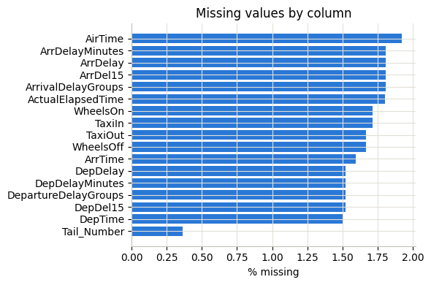
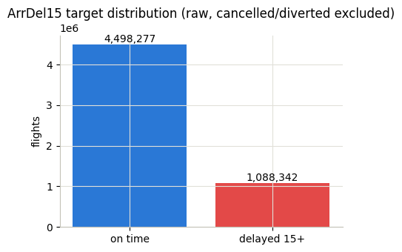
What is missing, and why
Only the flights that never landed normally
Every gap sits in an arrival or departure field
Cancelled and diverted flights carry no arrival delay
Imputing an arrival delay for a flight that never arrived would invent data, so those rows are dropped.

Slide 6
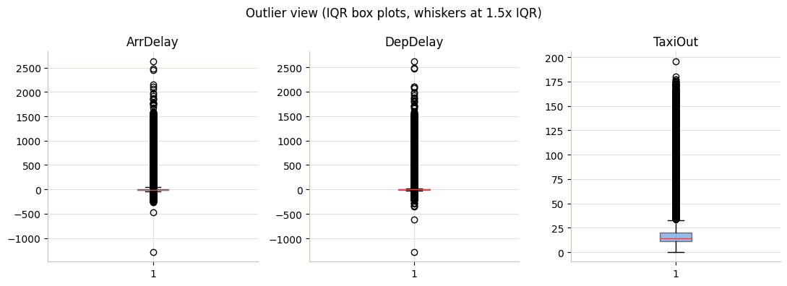
Outliers are the phenomenon
The IQR rule flags 9 to 13% of the delay columns
Skewness
ArrDelay 8.46
DepDelay 9.56
TaxiOut 3.14
9.4% and 13.1% of rows flagged
Removing them would delete exactly what the project exists to predict, so all of them stay.

Slide 7
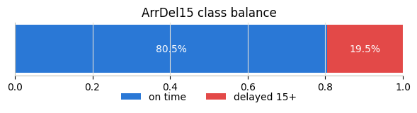
Imbalanced enough to matter
Predicting on time for every flight already scores 80%
So Accuracy is not the metric
ROC-AUC is the headline, it needs no threshold
Precision, Recall and F1 sit next to it
class_weight balanced where supported
80.5%
19.5%
0.821
landed on time
landed 15 minutes late or more
F1 on the delayed class
Not extreme, but enough that a model doing nothing at all would still look 80% right.

Slide 8
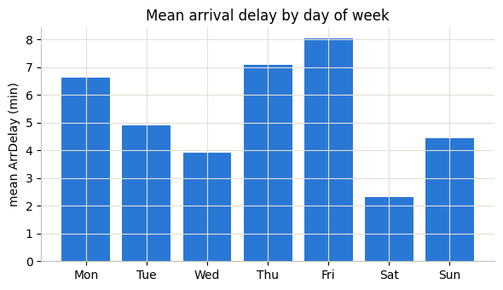
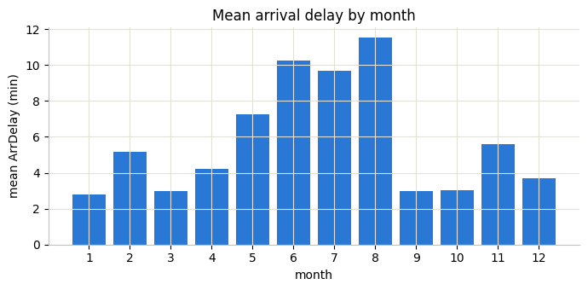
When flights run late
Season and weekday both carry real signal
Friday is worst, Saturday is calmest
Summer is roughly 3x worse than autumn
August averages 11.5 minutes against 2.8 in January. Thunderstorm season shows up directly in the target.

Slide 9
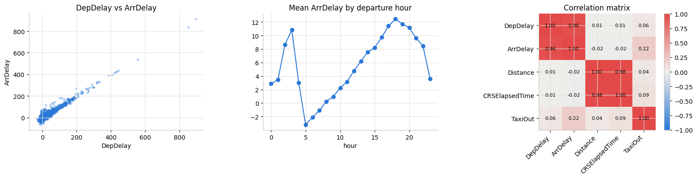
What actually predicts delay
One feature carries almost the whole problem
0.96
0.22
-0.02
DepDelay to ArrDelay
TaxiOut to ArrDelay
Distance to ArrDelay
Delay compounds through the day, from -3 minutes at 5am to +12 by 6pm.

Slide 10
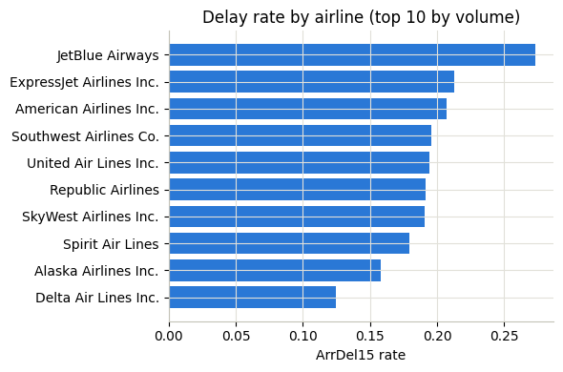
Carriers are not equal
Same scale, very different outcomes
Delay rate, ten largest carriers
JetBlue 27.3%
ExpressJet 21.3%
American 20.7%
Southwest 19.6%
United 19.5%
Alaska 15.8%
Delta 12.5%
JetBlue is delayed more than twice as often as Delta, so Airline earns its place as a feature.

Slide 11
The leakage boundary
The one decision that sets the ceiling
Legal at departure
Banned, known only after landing
DepDelay, how late it left the gate
TaxiOut, time from gate to wheels up
CRSElapsedTime and the schedule
Airline, Origin, Dest, Month, DayOfWeek
ArrTime, WheelsOn, TaxiIn
ActualElapsedTime, AirTime
ArrDelayMinutes, ArrivalDelayGroups
DivAirportLandings
Enforced in code, not by intention
The feature list is asserted against a banned list before any model is fitted, and the split happens before any target dependent statistic is computed.
Move this boundary to before departure and the same data tops out near 0.70.

Slide 12
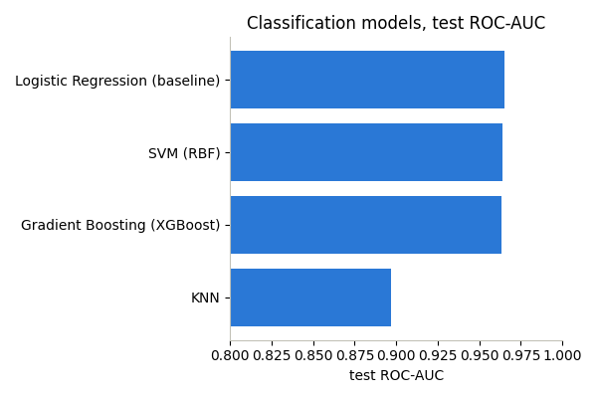
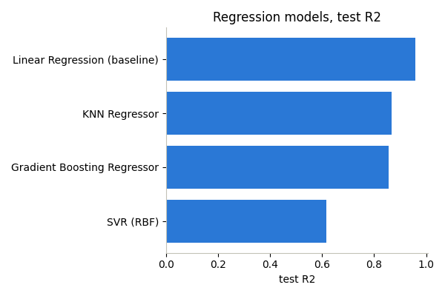
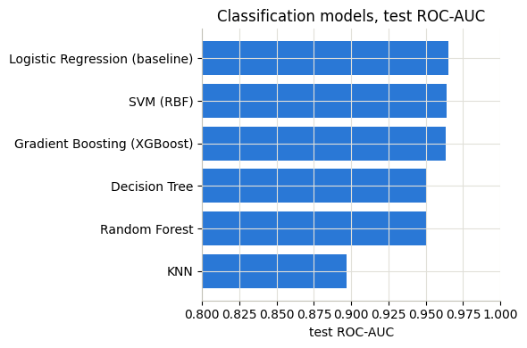
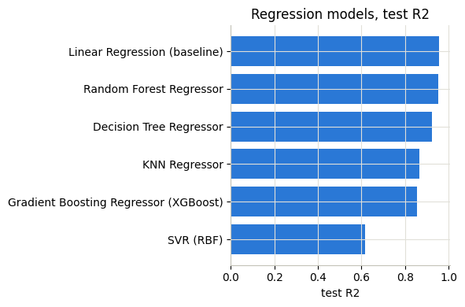
Eight models, two problems
Four algorithms per target on one shared split
Logistic Regression leads on test ROC-AUC
Linear Regression leads on test R2
Logistic 0.9649 against XGBoost 0.9631. Linear Regression beats every complex model on regression outright.

Slide 13
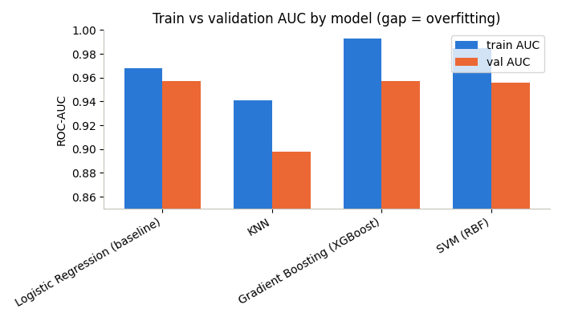
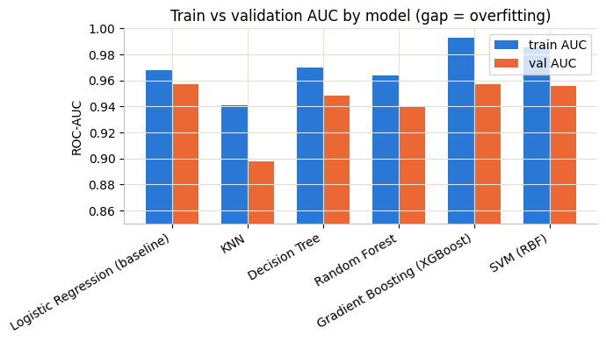
Nobody badly overfit
Train AUC minus validation AUC
The gap, model by model
Logistic 0.011
SVM 0.030
XGBoost 0.036
KNN 0.043
Under 0.02 generalises well, over 0.05 is substantial
No model is past 0.05 at its chosen settings, but XGBoost and SVM are the two to watch.

Slide 14
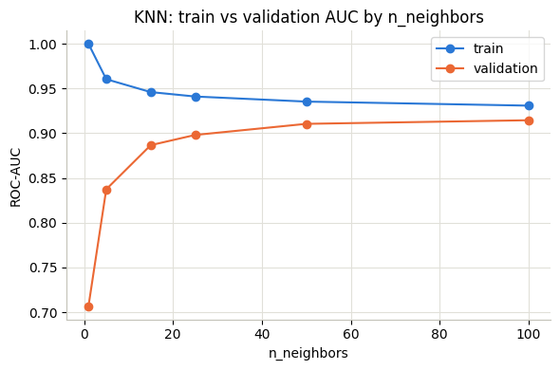
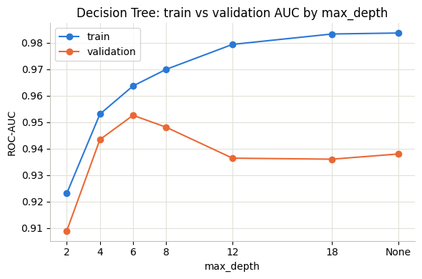
Complexity has a peak
Validation rises then falls while training keeps climbing
KNN: k=1 memorises, gap 0.293. Chosen k=50
At k=1 the model scores a perfect 1.000 on training data and 0.707 on data it has not seen.

Slide 15
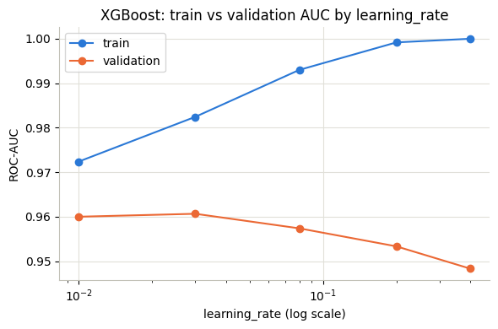
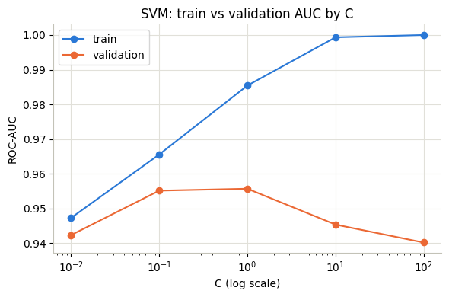
The same shape, twice more
Boosting and margin width behave identically
XGBoost: validation peaks at learning rate 0.03
SVM: validation peaks at C=1, gap 0.060 by C=100
Complexity has to be tuned against a validation set, never chosen by what looks best on training data.

Slide 16
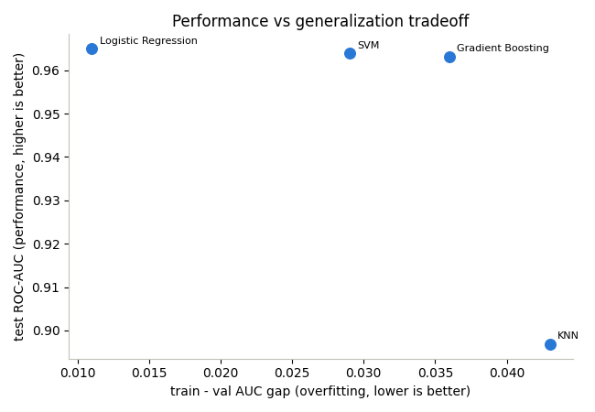
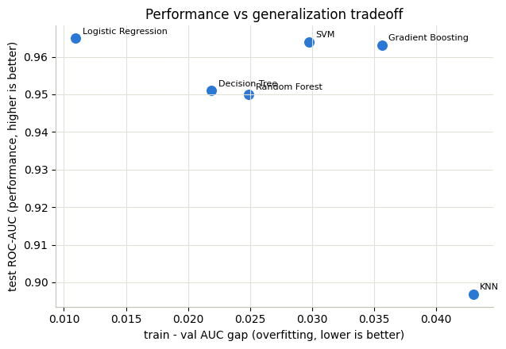
Simple won
Performance against generalisation
Selected classifier
Logistic Regression. Best test ROC-AUC, smallest gap, trains in under a second, coefficients you can read.
Selected regressor
Linear Regression. Best test R2 and MAE of all four, because ArrDelay is close to linear in DepDelay.
The best model is not the most sophisticated one. It is the one that generalises and fits the deployment.

Slide 17
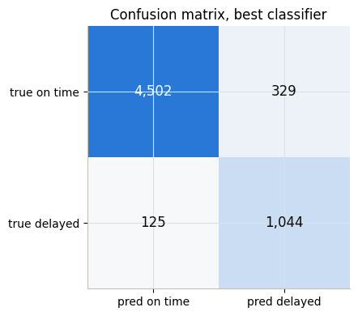
Where the model fails
125 flights it could never have caught
False negatives, mean DepDelay 0.15 min
They left the gate on time and lost the time in the air, after the moment this model makes its call.
False positives, mean DepDelay 12.3 min
They looked risky at departure and made the time back. Genuinely uncertain, not a modelling error.
The real limit is the in air delay. No feature available at departure can see it. That is data, not modelling.

Slide 18
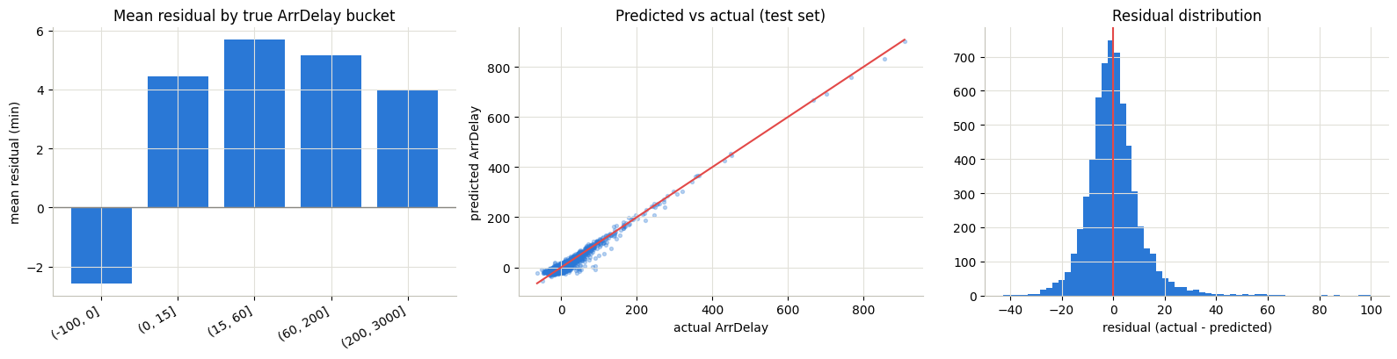
The residuals lean one way
Under prediction on every delayed bucket
-2.6 min
+4 to +6 min
7.29 min
on time flights, slight over prediction
every delayed bucket, under predicted
mean absolute error on test
Once a delay is underway, the model consistently guesses it will be milder than it turns out to be.

Slide 19
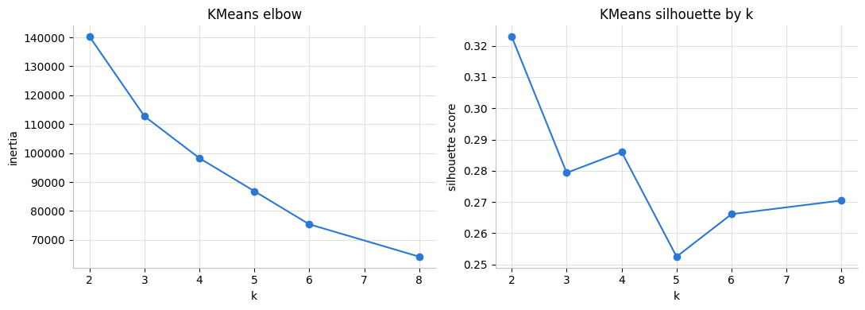
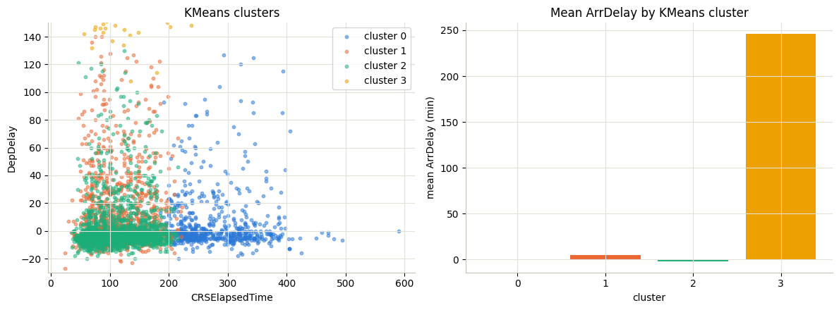
Clusters nobody labelled
KMeans on schedule and ground features only, no target
Silhouette peaks at k=2, k=4 is more useful
One cluster sits far above the rest
Cluster 3: 612 flights, mean ArrDelay 245.8 minutes, 100% delayed
KMeans isolated a severe delay segment on its own, from schedule and ground features alone, without ever seeing the target column.
Unsupervised learning found the thing the supervised models were trained to predict.

Slide 20
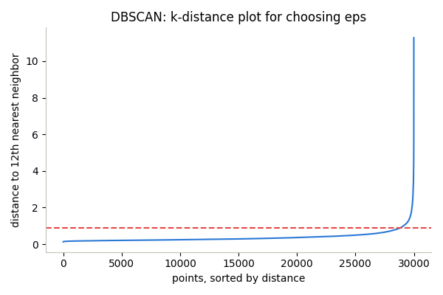
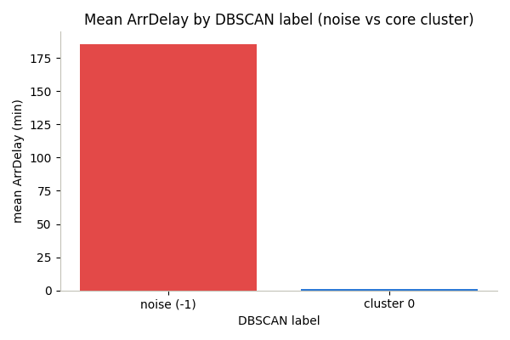
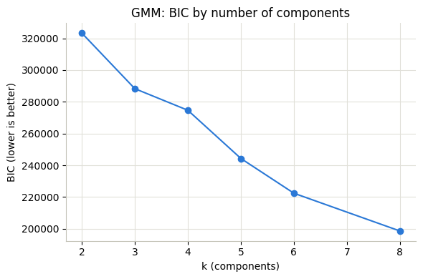
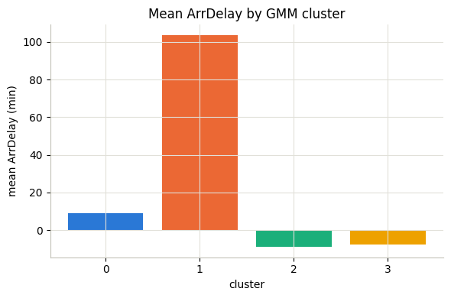
The same segment, found twice
A different algorithm reaches a similar answer
eps=0.90 chosen from the k-distance knee, min_samples=12
Noise: TaxiOut 39.1 min, 92% delayed
DBSCAN labels 2.3% of flights as noise instead of forcing a cluster count, and agrees with KMeans on about half of its severe delay group.

Slide 21
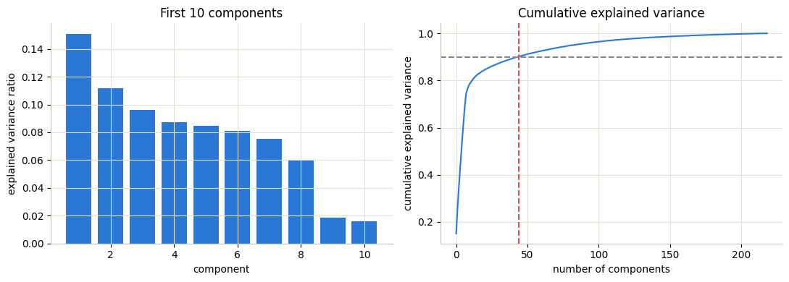
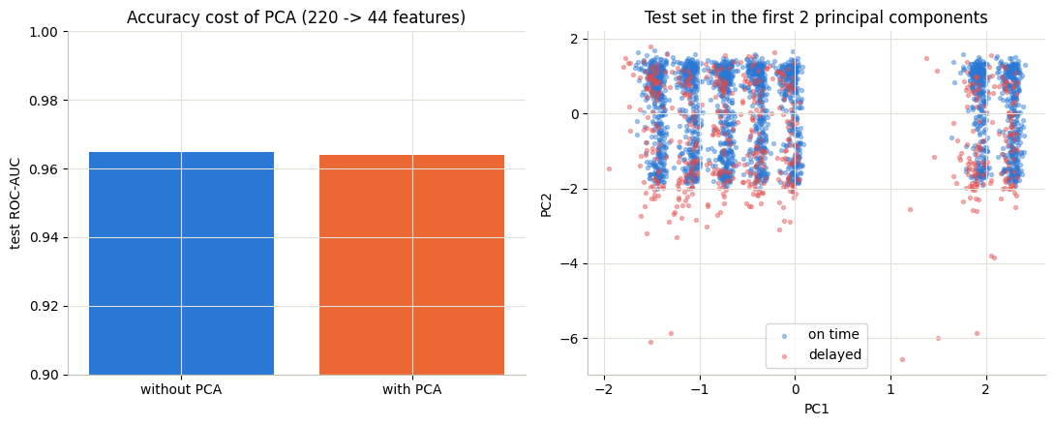
220 columns into 44
Ninety percent of the variance, for 0.0009 of AUC
44 components reach 90% of the variance
The two classes overlap heavily in 2D
220 to 44
0.9649
0.9640
a five fold reduction in columns
test ROC-AUC without PCA
test ROC-AUC with PCA
Useful as compression for a slower model or a lighter deployment. Not needed for accuracy here.

Slide 22
What the data says
Six findings that shaped the result
01
02
03
Departure delay is the problem
The boundary sets the ceiling
Simple models won both
0.96 correlation with arrival
0.96 after, about 0.70 before
Logistic 0.965, Linear R2 0.958
04
05
06
Delay compounds through the day
The failures are in the air
Clustering found it unsupervised
-3 min at 5am, +12 by 6pm
false negatives left on time
612 flights, 245.8 min, no target
The framing decision in Part 1 mattered more to the final numbers than any model or hyperparameter after it.

Slide 23
What we would do about it
Each one tied to a finding
Ship it for post departure updates
gate and connection planning, passenger comms
1
Do not use it before departure
that is a different and much harder problem
2
Add weather along the route
the in air delay is the only real blind spot
3
Deploy the linear models
they win on score, speed and interpretability
4
Build the pre departure version
so the value of waiting is measurable
5

Slide 24
WHAT WE TOOK AWAY
The framing is the model,
not the algorithm.
Hardest
Best judgement
Next time
deciding exactly when now is, TaxiOut sits on the line
keeping the outliers, they are the whole point
build the pre departure model side by side
Thank you
Khalid Al Dosari · Abdulaziz Alshareef · Anas Alzahrani · Feras Madkhali

